Slide 1

Cryptocurrencies, Blockchain Introduction
What is a Cryptocurrency? What is Blockchain?

Slide 2
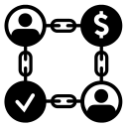
Table of Contents
What is Cryptocurrency?
Types of Cryptocurrencies
What is Blockchain?
Benefits of Blockchain network

Slide 3
What is Cryptocurrency?

Slide 4
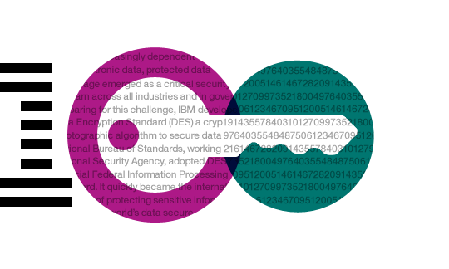
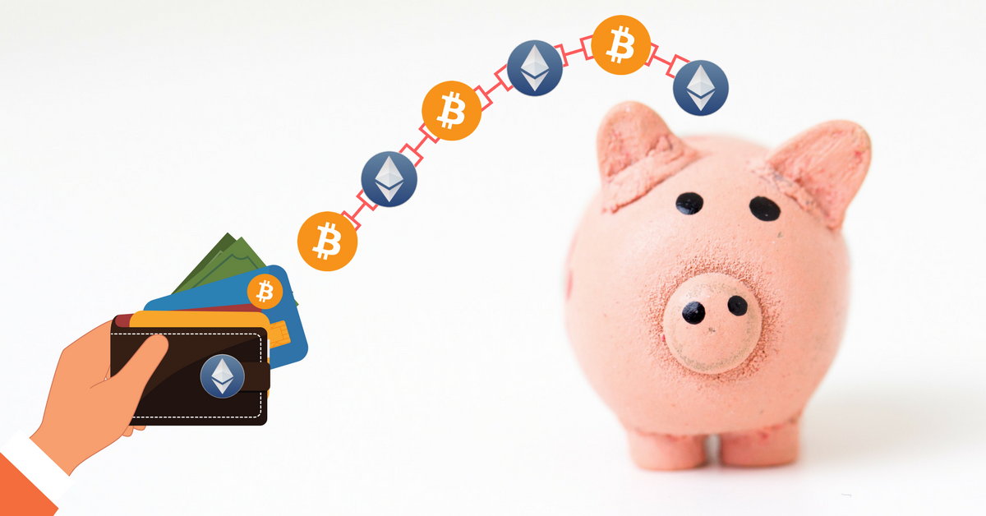
Cryptocurrencies
Digital currency
Built with cryptographic protocols
Cryptography provides a way to hide information
Make transactions secure and difficult to fake
Not controlled by any central authority

Slide 5

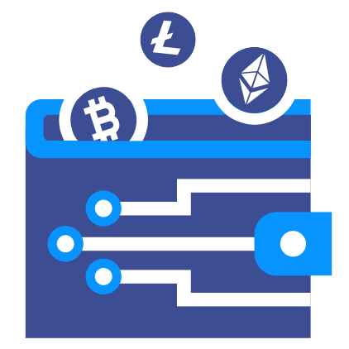
Wallets
A place where you securely store your Blockchain cryptocurrencies

Slide 6
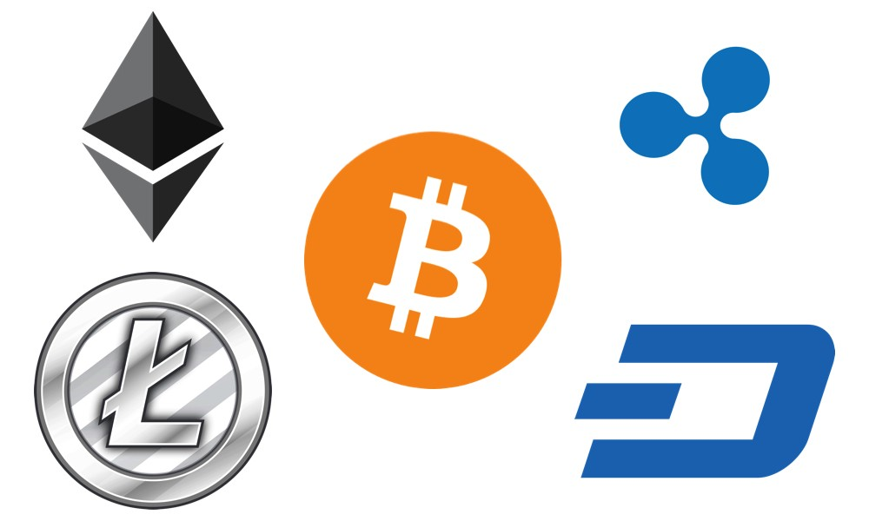
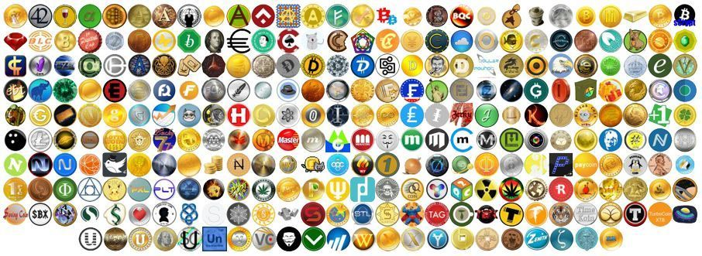
Types of Cryptocurrencies

Slide 7
What is Blockchain?

Slide 8










Slide 9


Slide 10


Slide 11


Slide 13


Slide 14
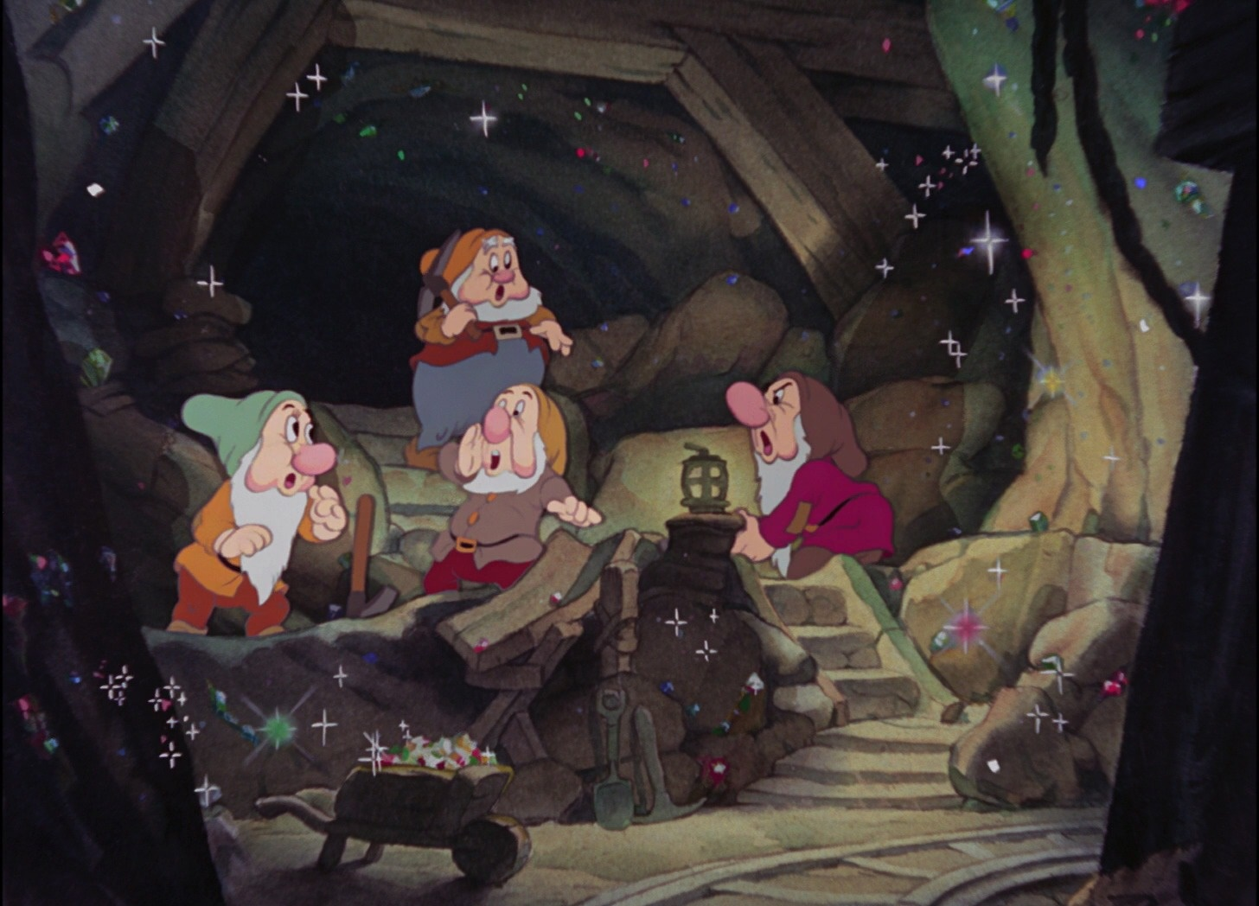

Slide 15
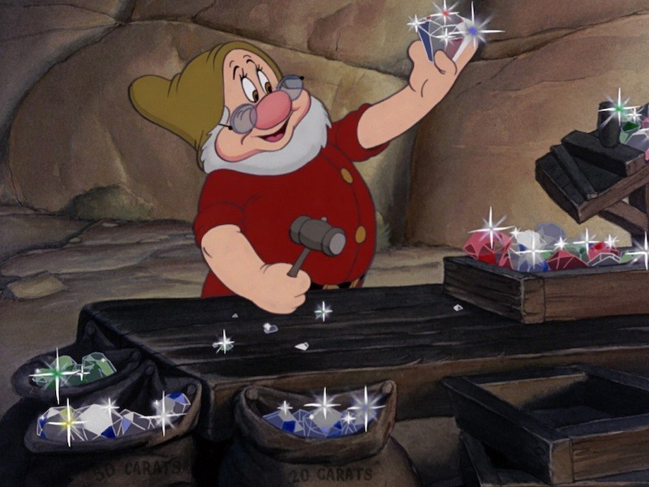

Slide 16

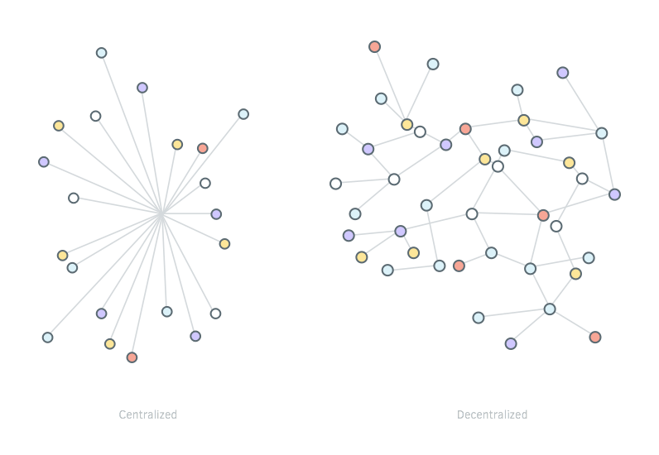
Blockchain
Big database for recording information
No need to trust anyone
Decentralized (doesn’t have a central point)
P2P network

Slide 17
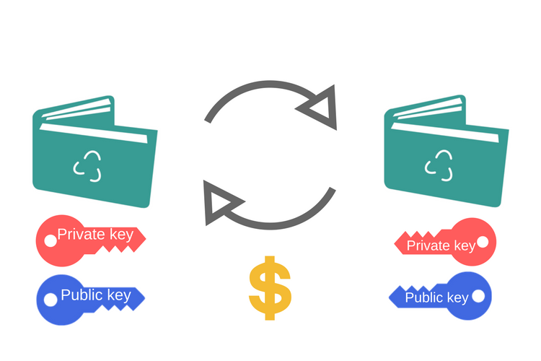

Blockchain
The information is packed into blocks which form a chain
All the information is encrypted and cannot be reversed

Slide 18
Have a Question?
Ask in sli.do
#blockchain-mini

Slide 19

Summary
Cryptocurrencies
Digital Currencies
Types of Cryptocurrencies
5 most popular – Bitcoin, Ethereum, LiteCoin, Ripple, Dash
Blockchain Introduction
Decentralized ledger, consisting of connected blocks holding transactions information, using cryptography
Benefits of Blockchain network
Decentralized
Trustless
Hard to hack

